Slide 1
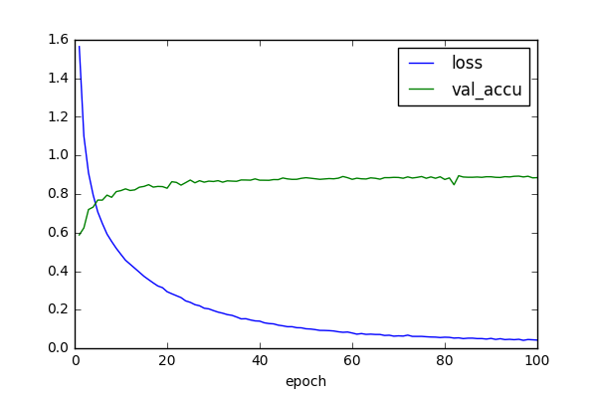
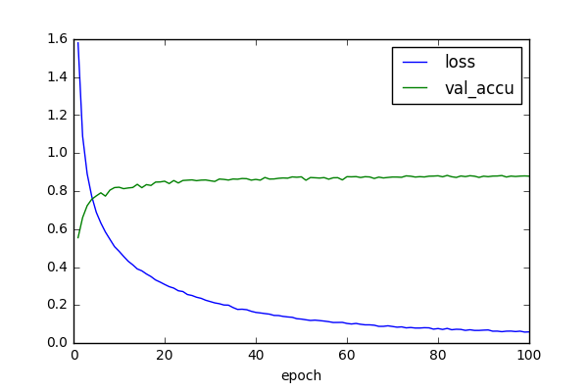
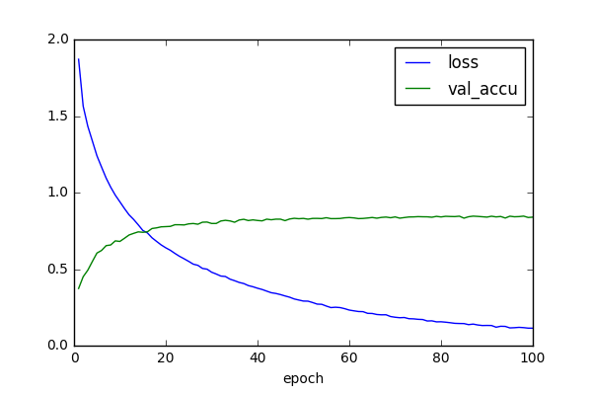
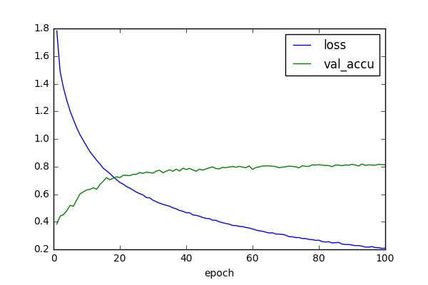
MATH 6380J Project 3: DCF-Net Exploration
Zengqiang Yan and Pei Wang {z.yan, pwangai}@connect.ust.hk
Department of Computer Science and Engineering, HKUST
1. Introduction
3. Analysis: Fashion-MNIST
5. Analysis: CIFAR-10
In a Convolutional Neural Network(CNN), parameters in filters are learned from large amount of training data recursively. In DCFNet, the filters are decomposed into the combination of pre-fixed bases, where only coefficients of the bases are learned during the training process. Therefore, this truncated expansion mechanism reduces the number of parameters as well as the redundancy in the network.
In this project, we explore the features of DCFNet by comparing the results to the conventional CNN models, and different bases are evaluated as well. The experiments are conducted on Fashion-MNIST and Cifar10 respectively.
Accuracy. Similar to the experimental results in the paper, the accuracy is slightly degraded by DCFNet, and the FB bases outperforms the random ones obviously. The reason is probably that pre-fixed bases limits the learning capacity of CNN models.
Decreasing #param. v.s Increasing training time. On the same computer and GPU (Titan X pascal), the DCFNet manages to reduce the number of parameters under the same network architecture by 30% on these cases, but the training time increases 23~50% as well.
No significant improvement on learning capacity by the DCFNet.
Accuracy: Adopting VGG-16 is able to achieve the best performance on the CIFAR-10 dataset. Comparatively, replacing the convolution kernels with DCF convolution kernels would degrade the performance more significantly on this relatively more complicated dataset.
Model complexity: As DCF convolution operations just adopt a series of pre-fixed bases, the model complexity can be reduced by about 30%.
Time complexity: Under the same configurations (Titan Xp GPU), using DCF convolution operations would significantly increase the time complexity.
Fashion-MNIST | Accuracy | # parameters | epoch duration
VGG16 | 93.23% | 10.3 M | 17s
VGG16_DCF_FB | 93.10% | 7.7 M | 26s
VGG16_DCF_rand | 92.74% | 7.7 M | 26s
ResNet18 | 92.91% | 11.3 M | 17s
ResNet18_DCF_FB | 92.24% | 7.5 M | 21s
ResNet18_DCF_rand | 91.57% | 7.5 M | 21s
VGG16 | VGG16_DCF | ResNet18 | ResNet18_DCF
VGG16 | VGG16_DCF | ResNet18 | ResNet18_DCF
4. Experiments on CIFAR-10
6. Conclusion
In this experiment, we adopted exactly the same deep learning models, but onto the CIFAR-10 dataset. In terms of data augmentation, we adopted the operations including random crop, random horizontal flip and normalization. As the CIFAR-10 dataset is more complicated than the Fashion-MNIST dataset, the maximum epoch is set as 100.
According to our implementations, on the Fashion-MNIST dataset, the DCF-Net could achieve comparable performance as original deep learning models. However, on the CIFAR-10 dataset, there exists a significant decrease in classification accuracy. On the other hand, using DCF-Net is able to achieve lower model complexity. Therefore, DCF-Net can be used for model compression on relatively easy tasks.
2. Experiments on Fashion-MNIST
Networks. Experiments have been conducted on two kinds of popular networks: VGG16 and ResNet18. For each network structure, we evaluate the Fashion-MNIST with normal convolutional layers and DCF layers. Besides, random and Fourier-Bassel bases are compared as well.
Data. Since the image size of Fashion-MNIST is only 28x28, we adapted the networks to the dataset by removing some pooling layers, conv layers and reducing the stride, but the architectures remain the same for different conv layers and pre-fixed bases.
CIFAR-10 | Accuracy | # parameters | epoch duration
VGG16 | 89.49% | 12.1M | 11s
VGG16_DCF | 88.26% | 9.5M | 21s
ResNet18 | 84.61% | 11.2M | 10S
ResNet18_DCF | 81.83% | 7.5M | 14s
7. Contribution
Fashion-MNIST & section 1-3: Pei Wang
Cifar10 & section 4-6: Zengqiang Yan

